Slide 1
Developer Exchange Group
深入淺出設計模式#6:
反覆器模式與合成模式
Prepare by Sean Hsieh

Slide 2
Agenda
Iterator pattern
Composite pattern

Slide 3
Iterator pattern

Slide 4
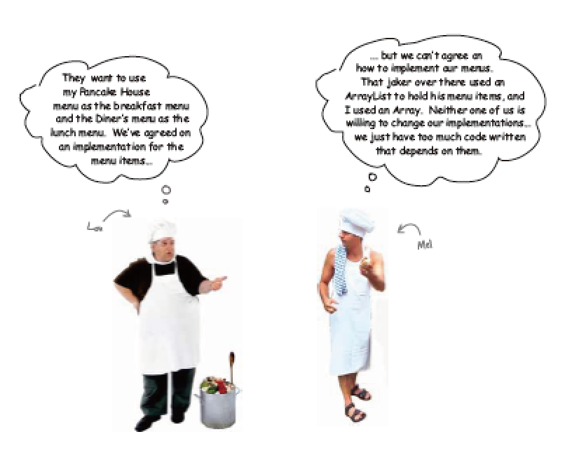
Scene
Different kind of container: List, Array
We have to enumerate items in different containers

Slide 5
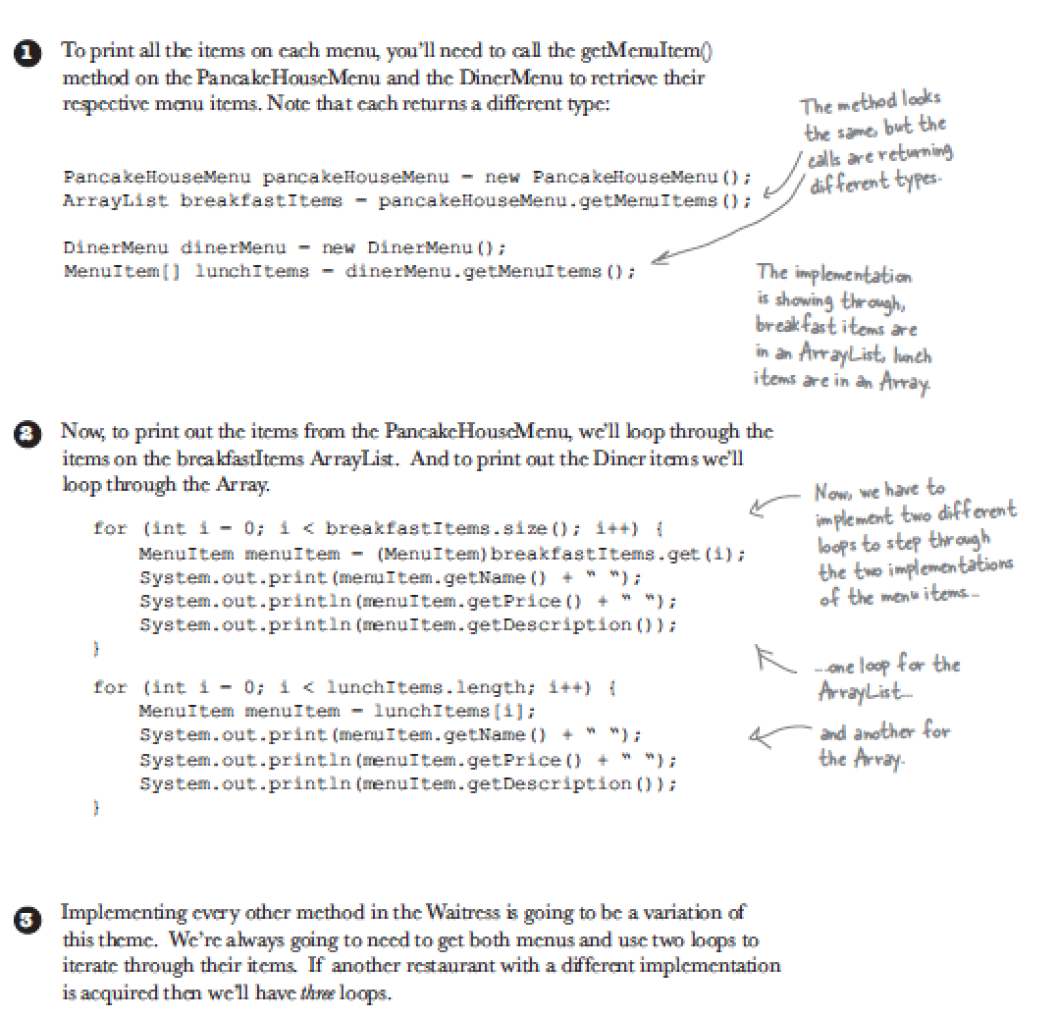
We hire(create) a waitress
First we use waitress to enumerate items

Slide 6
What’s wrong?
1. We code to the concrete implementation, not to an interface.
2.New type of menu.
3.Violates encapsulation.
4.If we added a third menu, we would have another loop

Slide 7
Class diagram (so far)
pancakehousemenu
waitress
dinnermenu

Slide 8
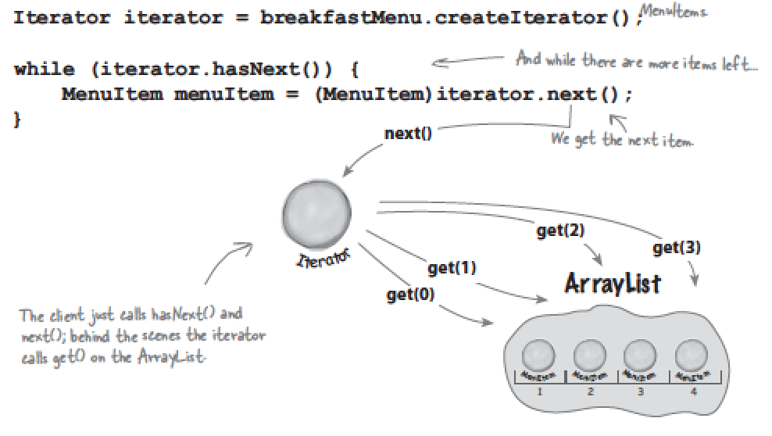
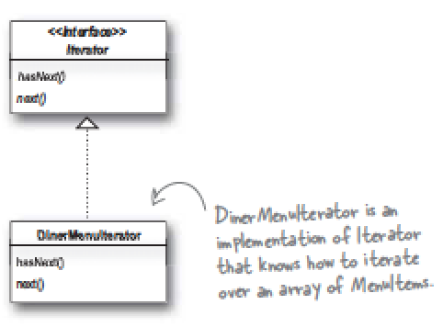
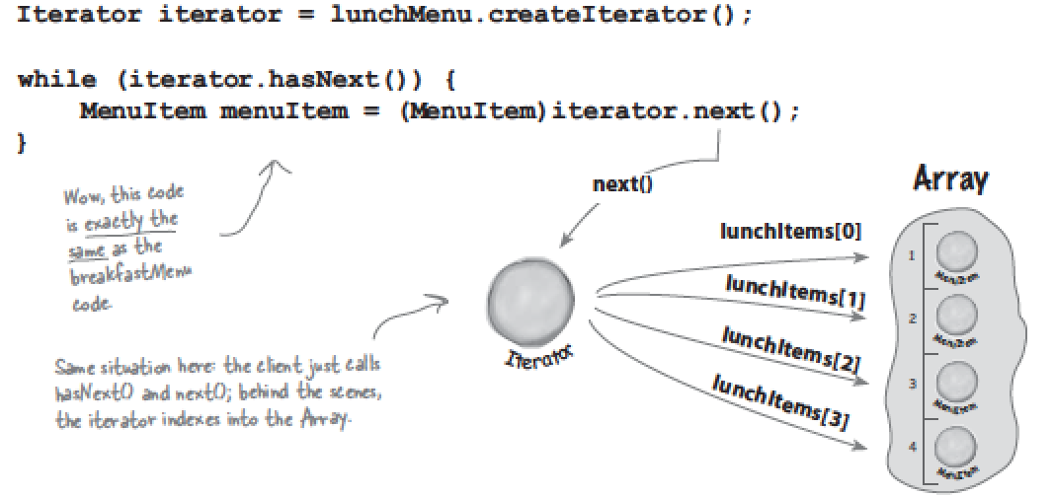
Encapsulation: Iterator pattern

Slide 9
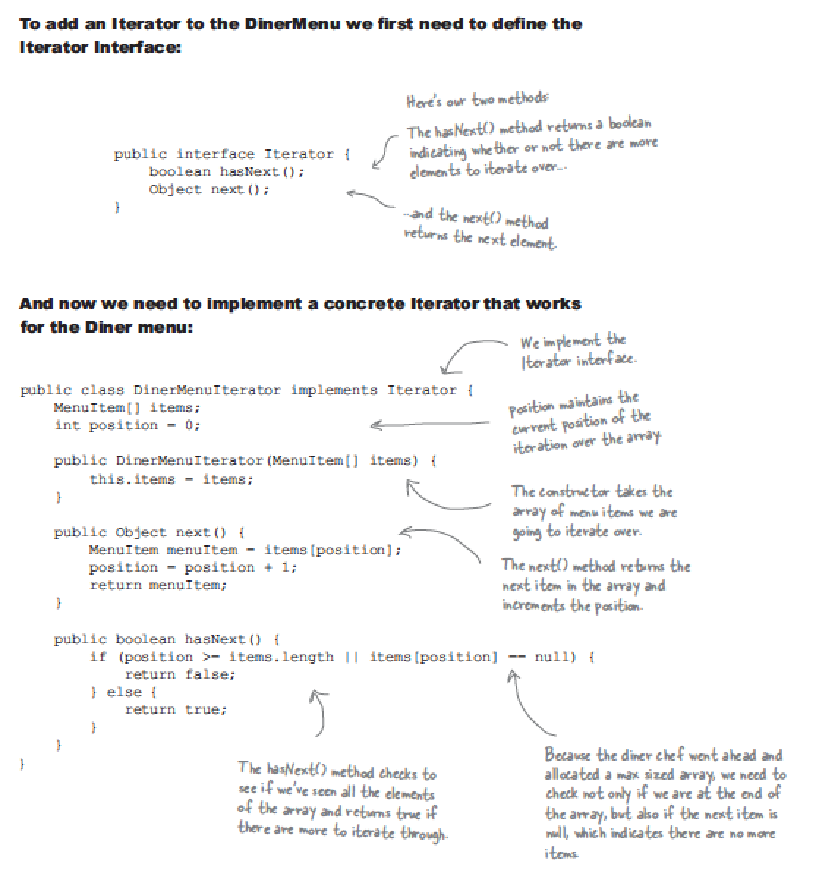
Encapsulation: Iterator pattern

Slide 10
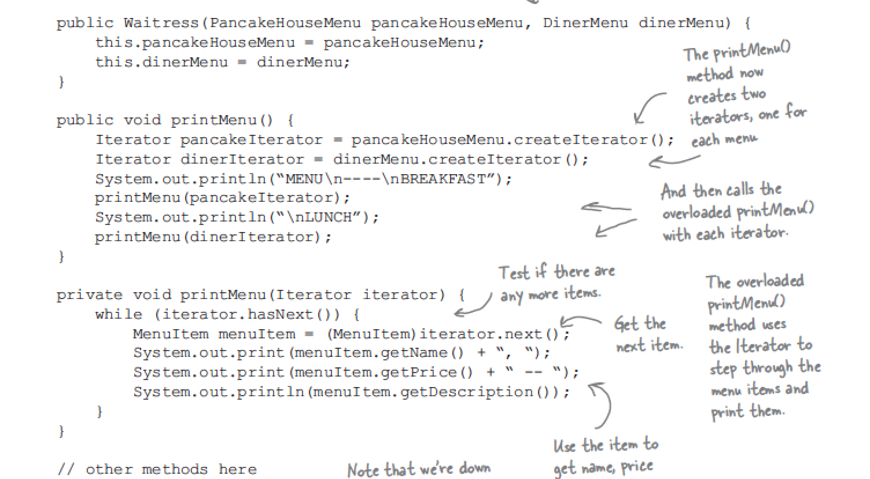
Encapsulation: Iterator pattern

Slide 11
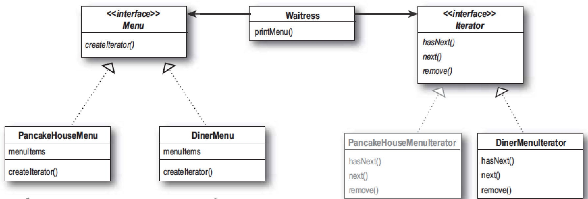
Class diagram (after modify)
pancakehousemenu
waitress
dinnermenu

Slide 12
After modify, we know..
1.The menu implement are now encapsulated
2.The loop that polymorphically handles any collection of items.
3.The waitress now uses an interface.

Slide 13
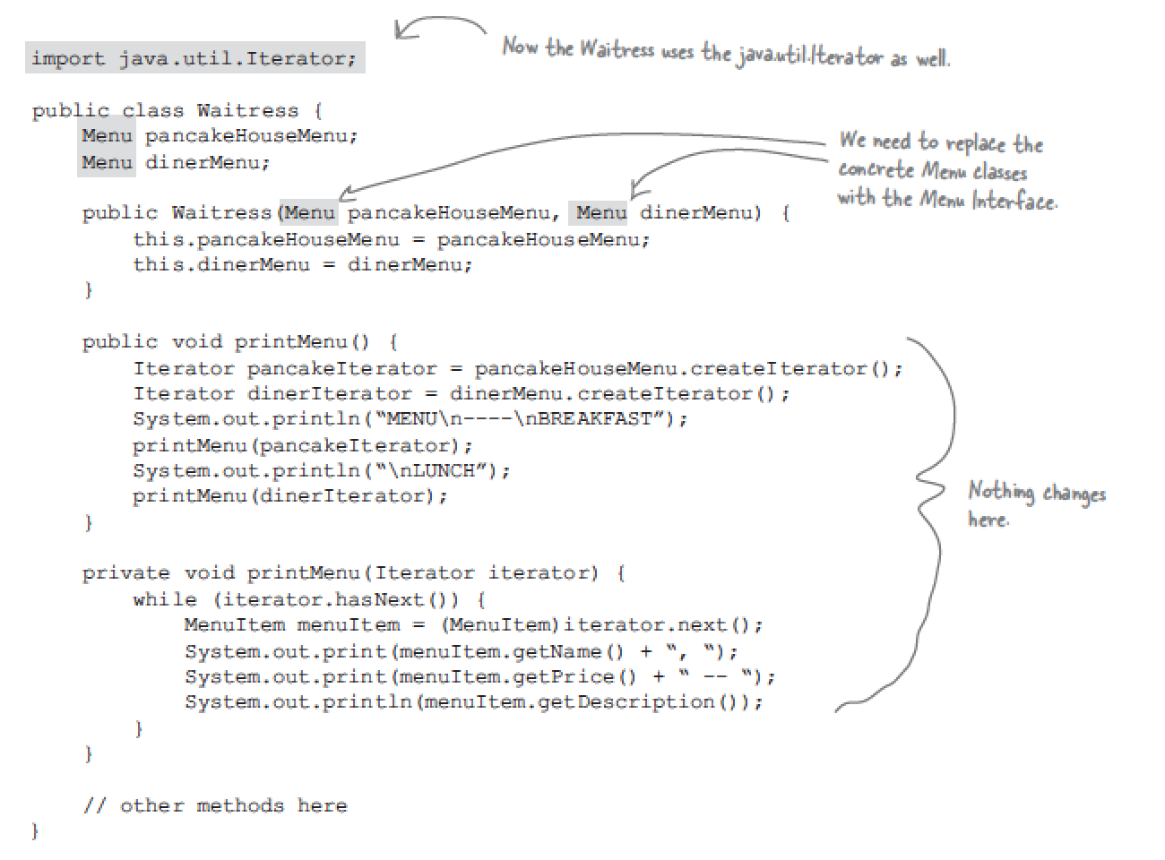
Final step: Let menu interfaces exactly the same

Slide 14
Design Principle: Single Responsibility
1. A class should have only one reason to change.
2.Having two ways to change increases the probability the class will change in the future, and when it does, it’s going to affect two aspects of your design.

Slide 15
Composite pattern

Slide 16
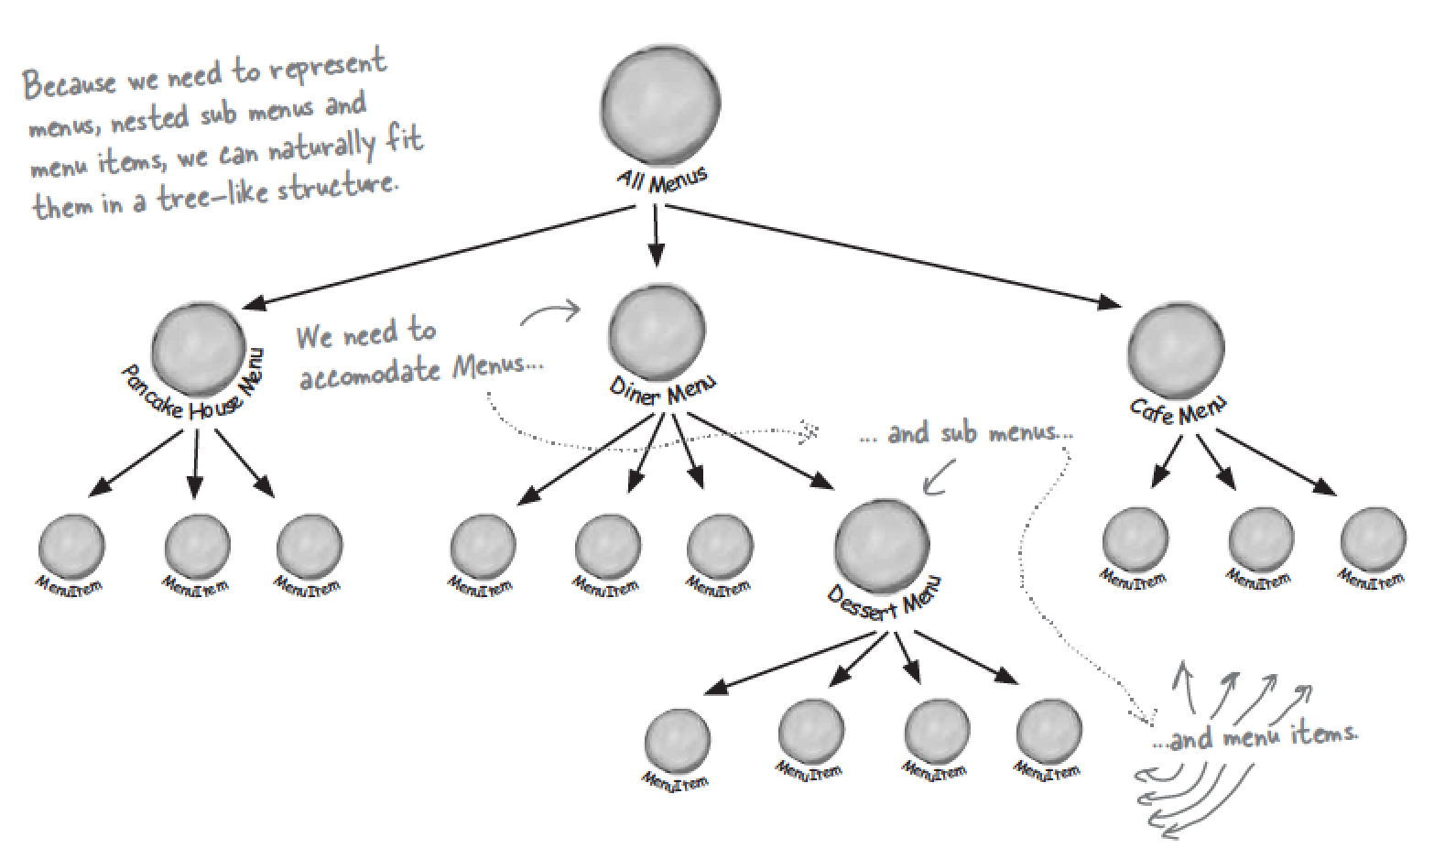
If we need sub menu…
The framework now we use can not handle that.

Slide 17
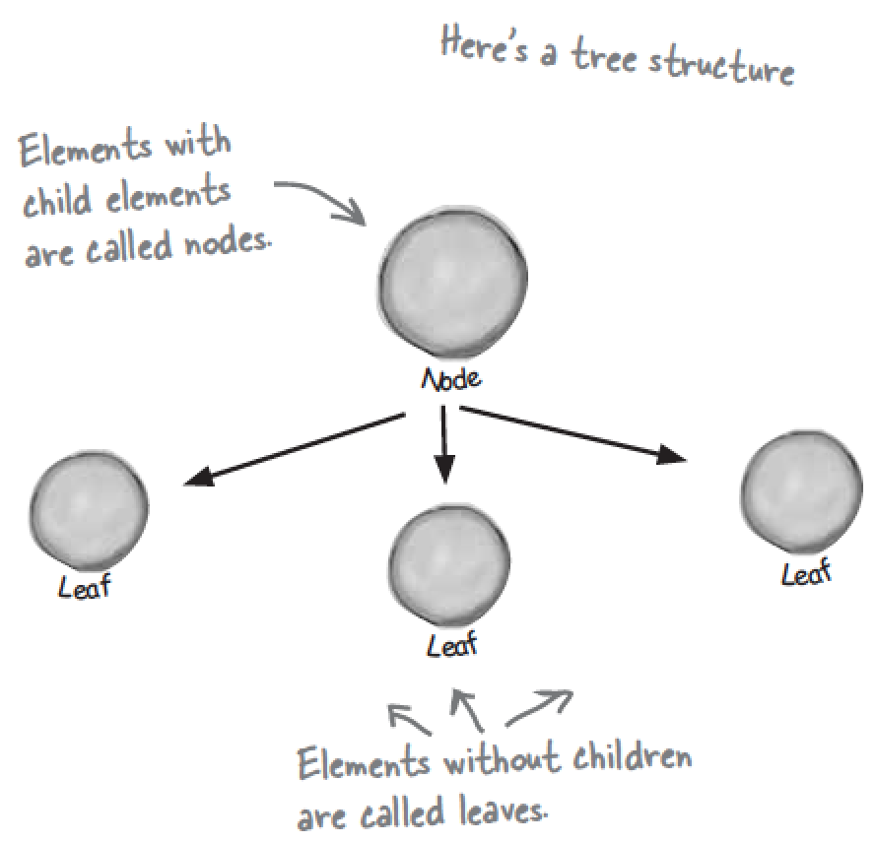
Apply composite pattern before coding
The composite pattern allow you to composite objects into tree structures to represent part-whole hierarchies.

Slide 18
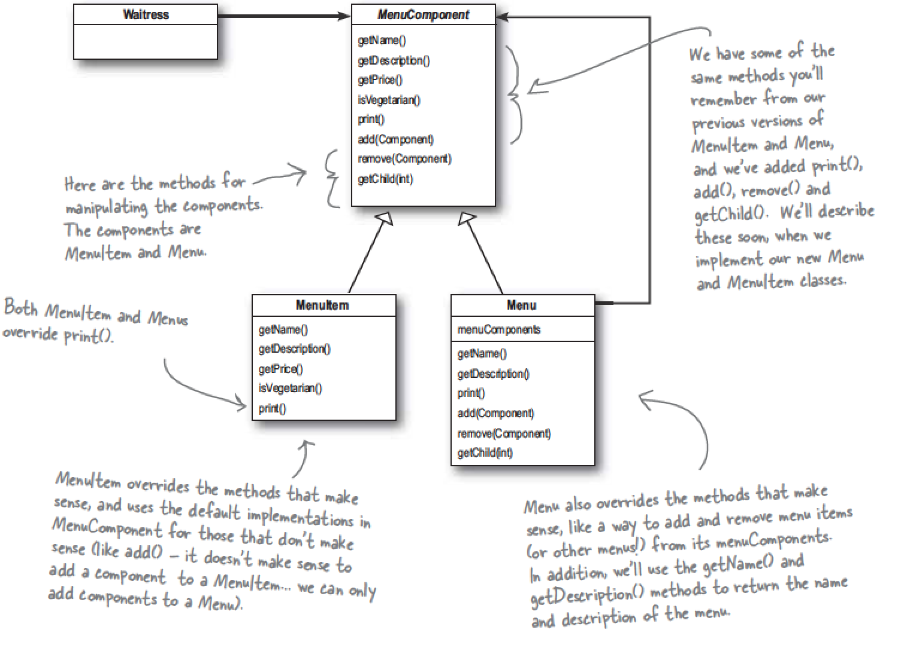
Class diagram

Slide 19
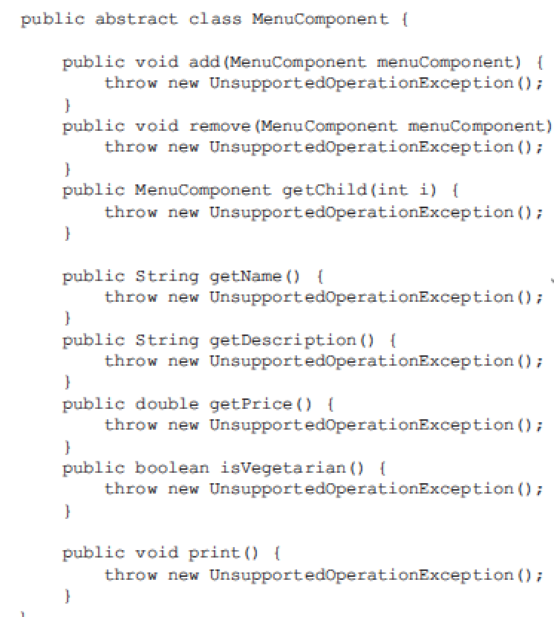
MenuComponent (super class)

Slide 20
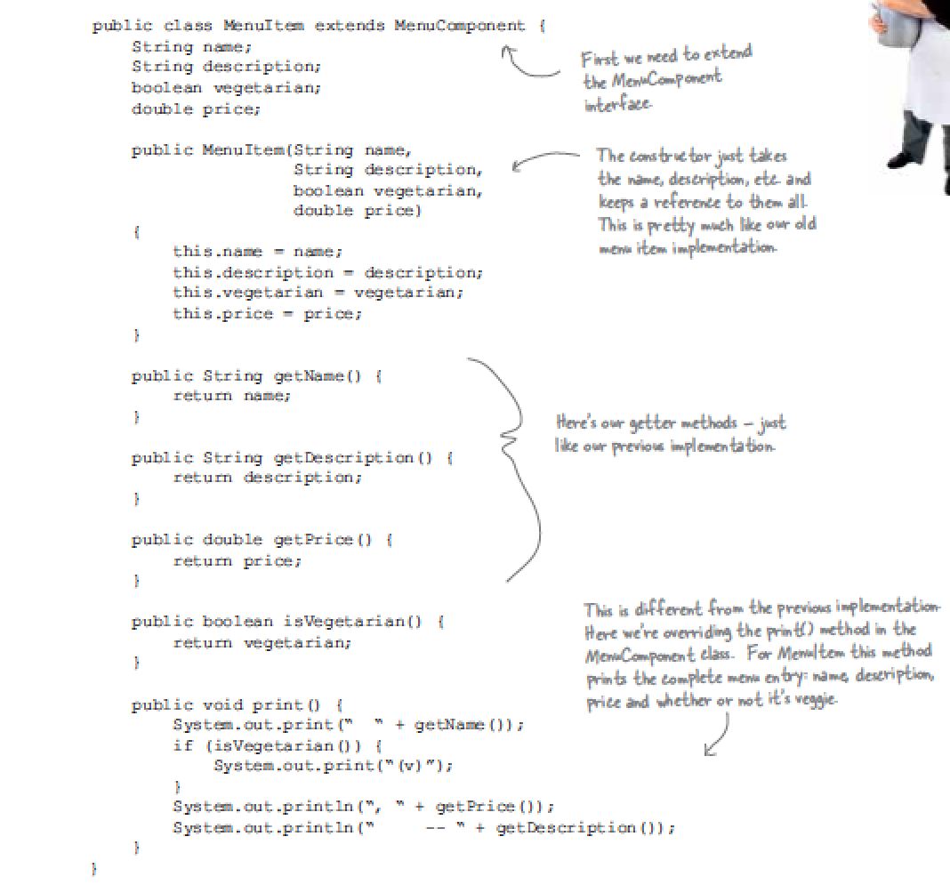
MenuItem (sub class)

Slide 21
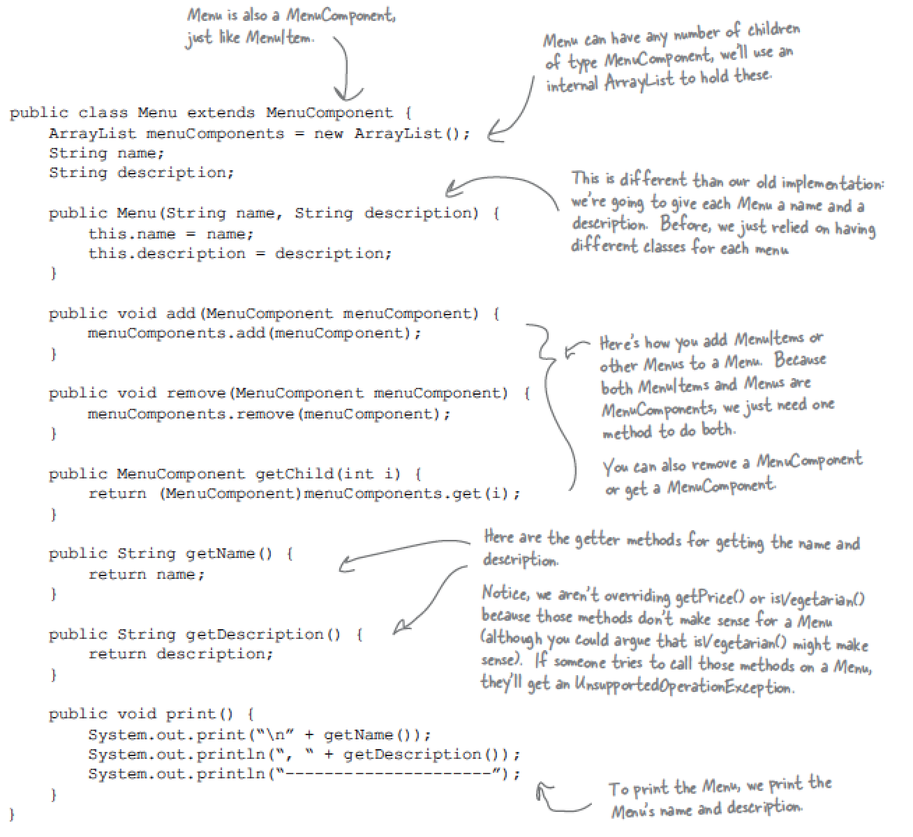
Menu (sub class)

Slide 22
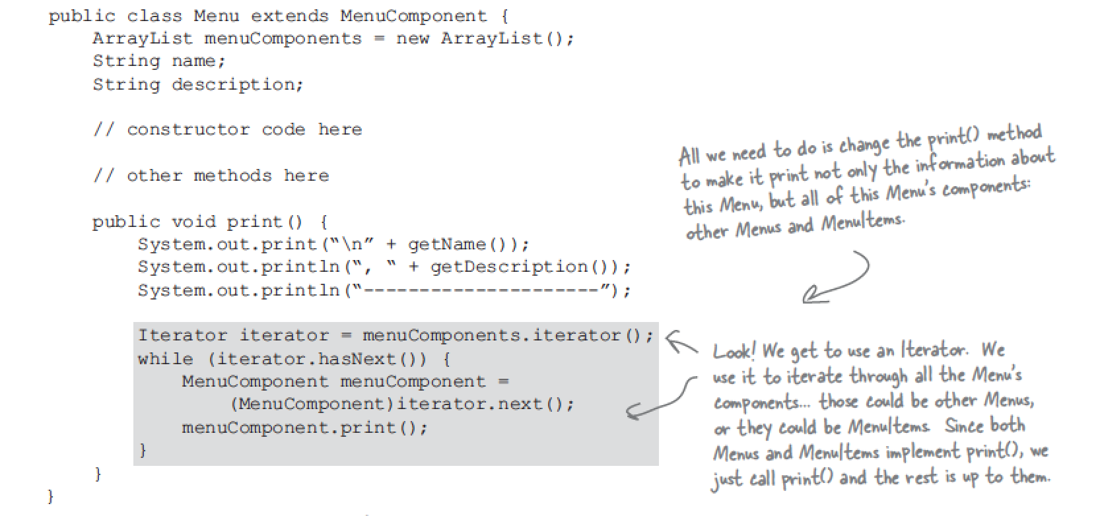
Recursive visit

Slide 23
After modify, we know..
1.The menu implement are now encapsulated
2.The loop that polymorphically handles any collection of items.
3.The waitress now uses an interface.

Slide 24
More

Slide 25
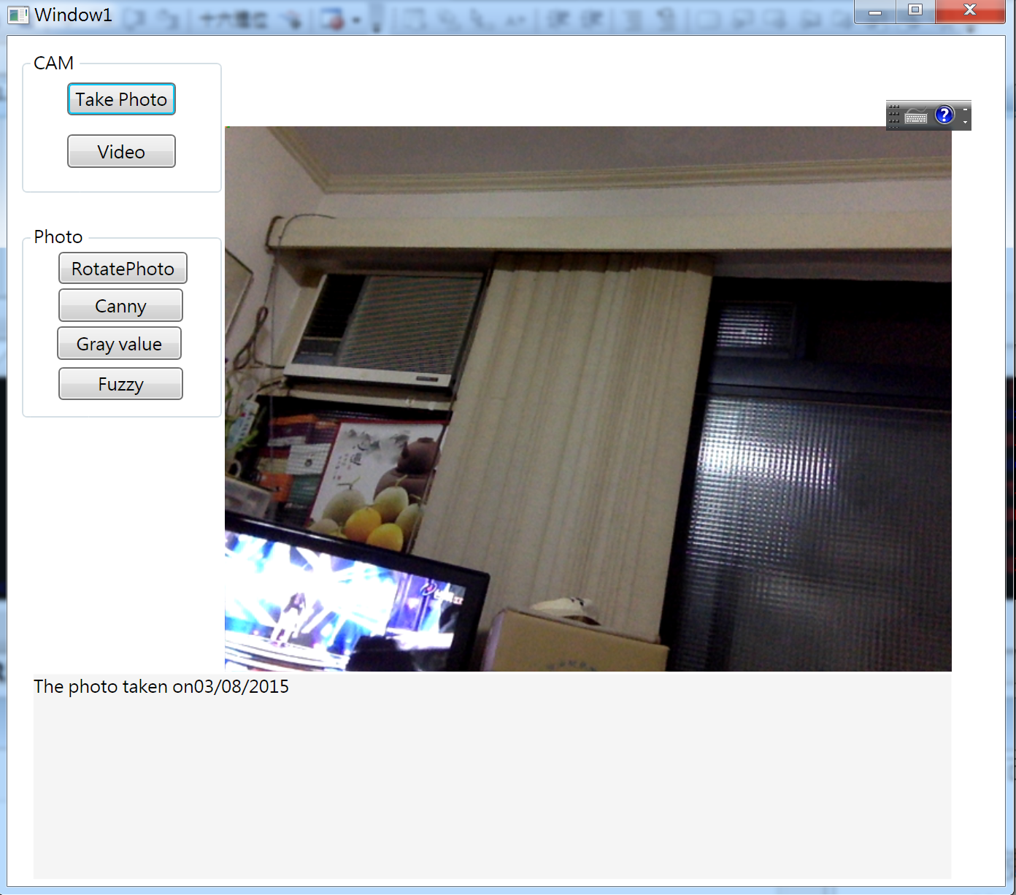
Image editor

Slide 26
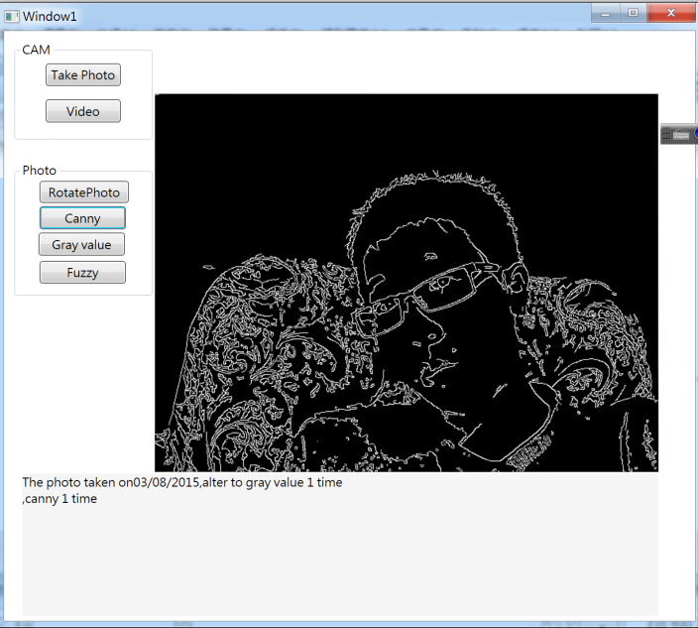
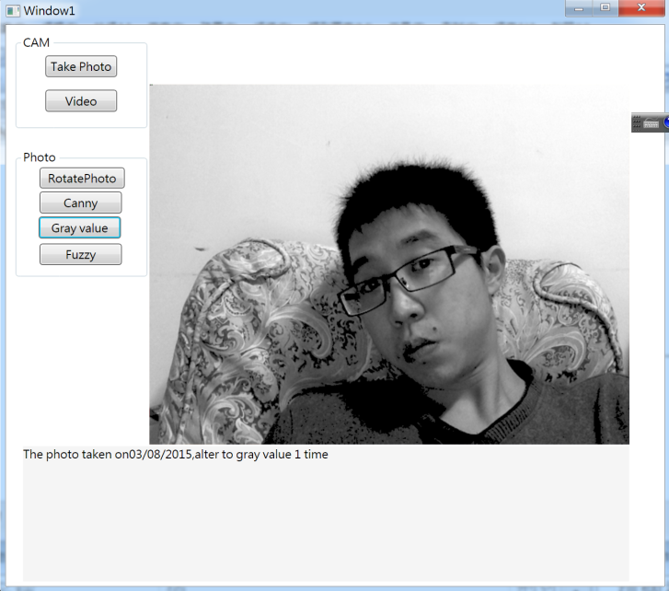
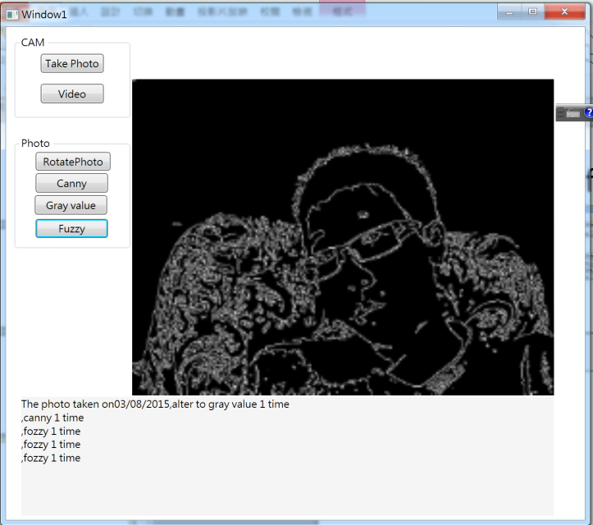
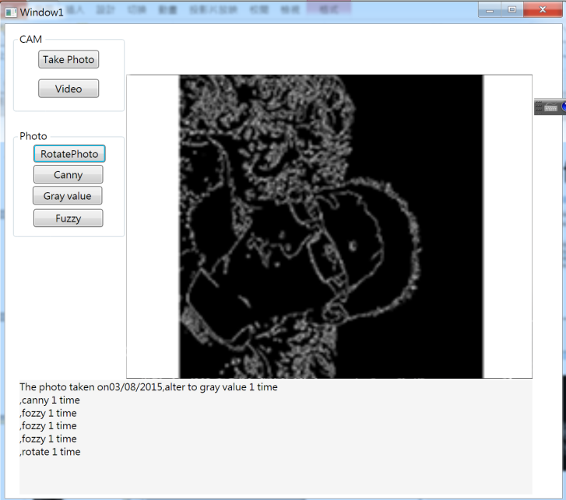
Functions of image editor

Slide 27
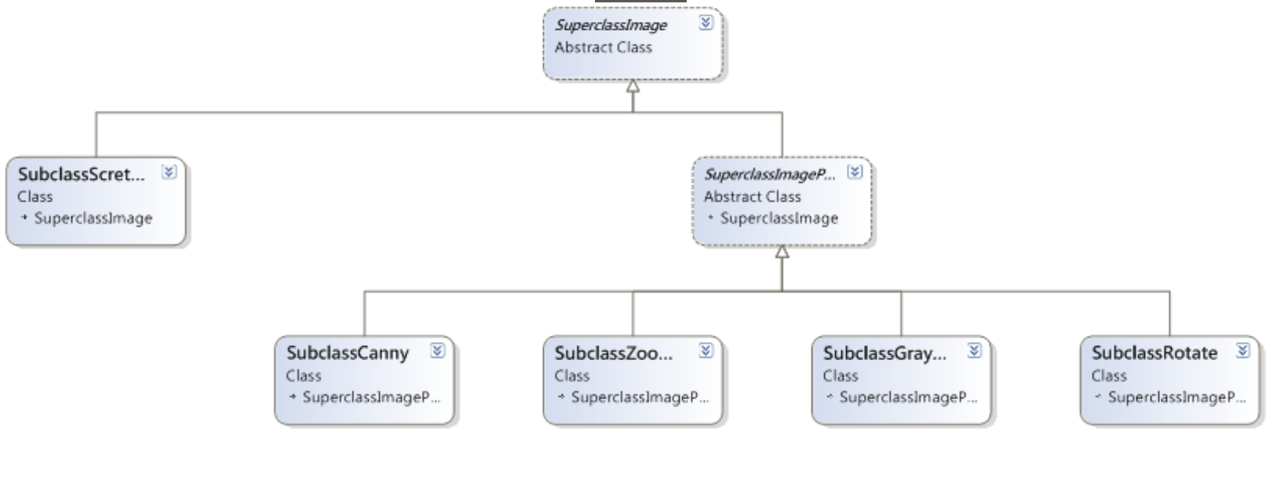
Class diagram of image editor

Slide 28
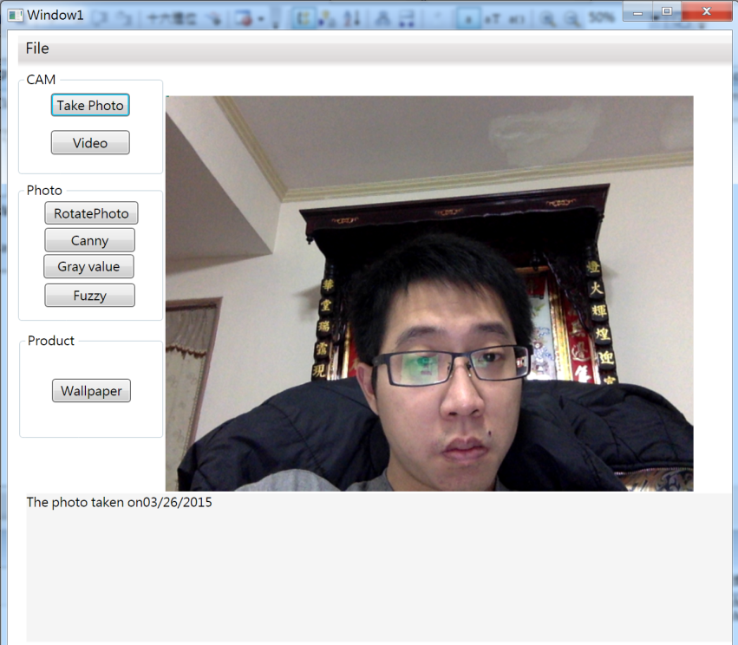
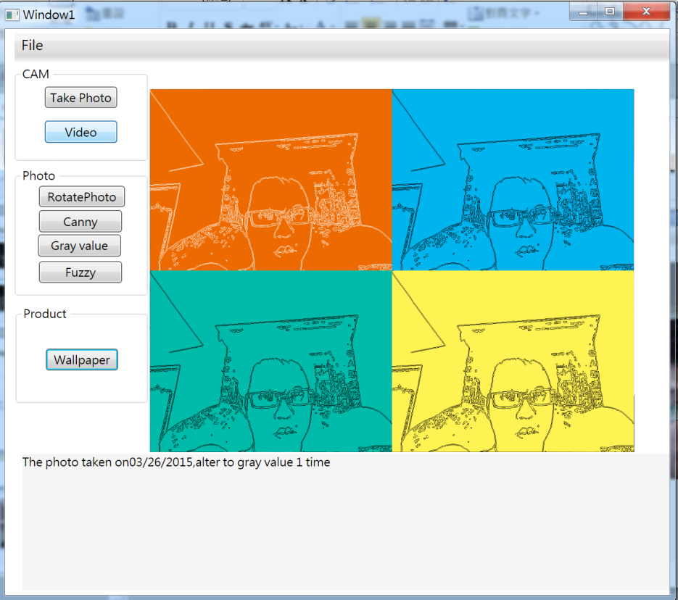
Wallpaper Product

Slide 29
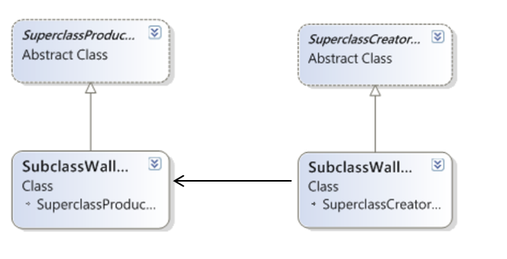
Class diagram of Wallpaper Product

